Slide 1
Intro

Slide 2
About Me (5 min)
Personal motivations – Family, Organic Vegetable gardening
Professional achievements - LinkedIn
Hobbies/Life Drivers - Travel

Slide 3
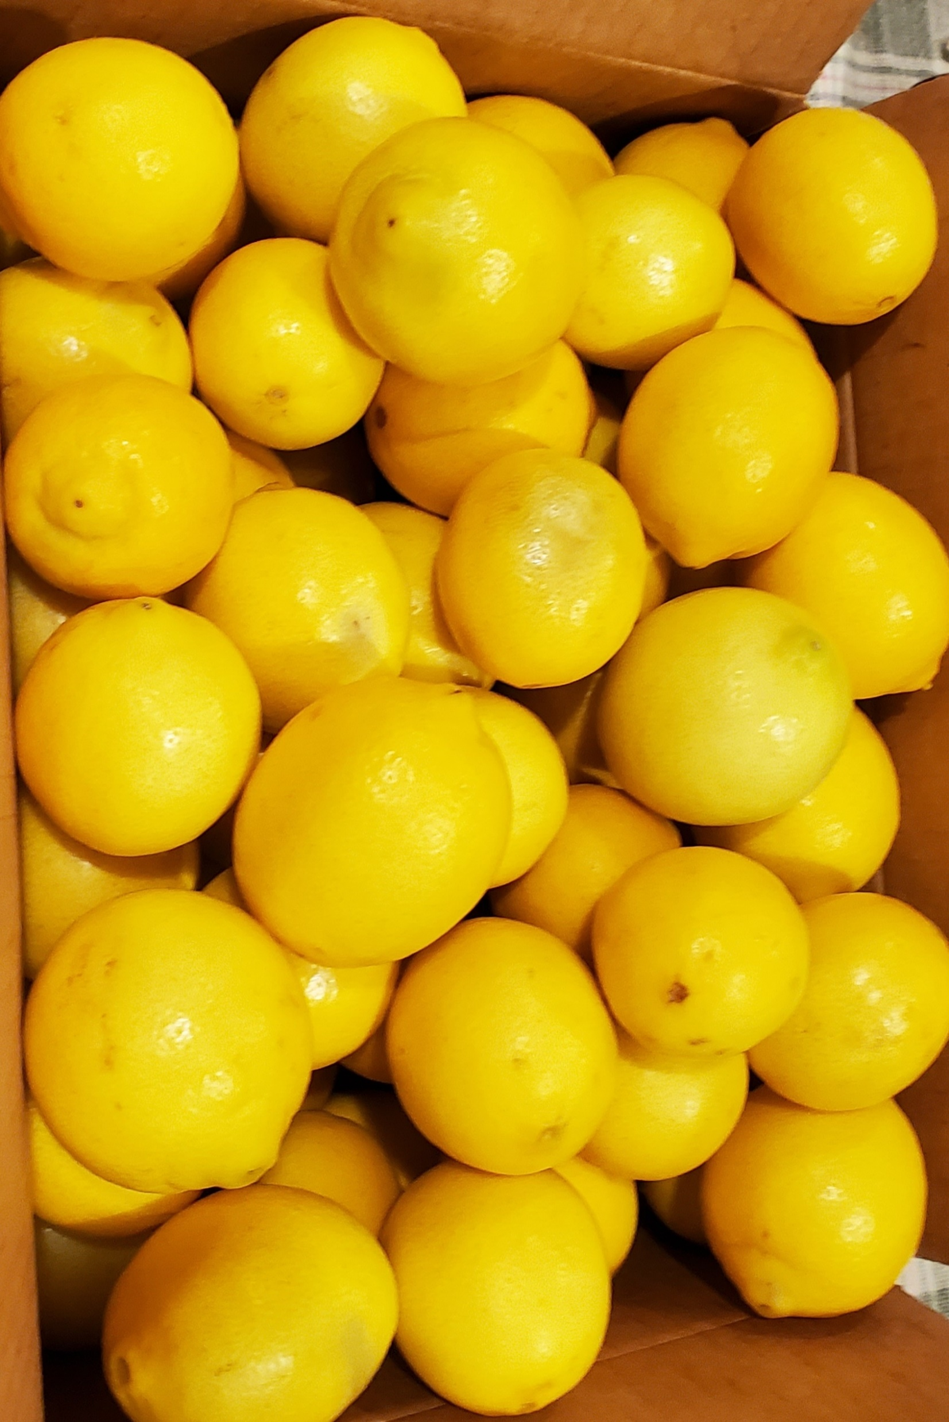

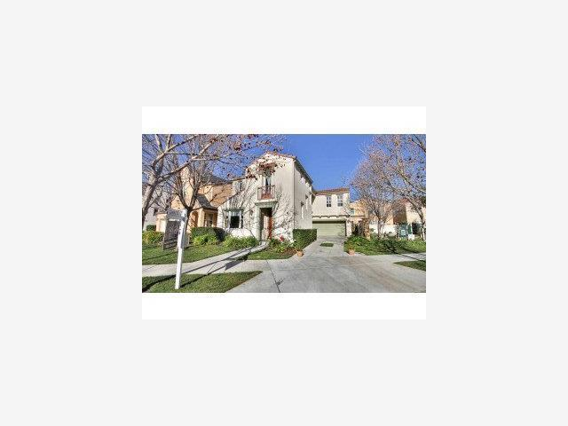

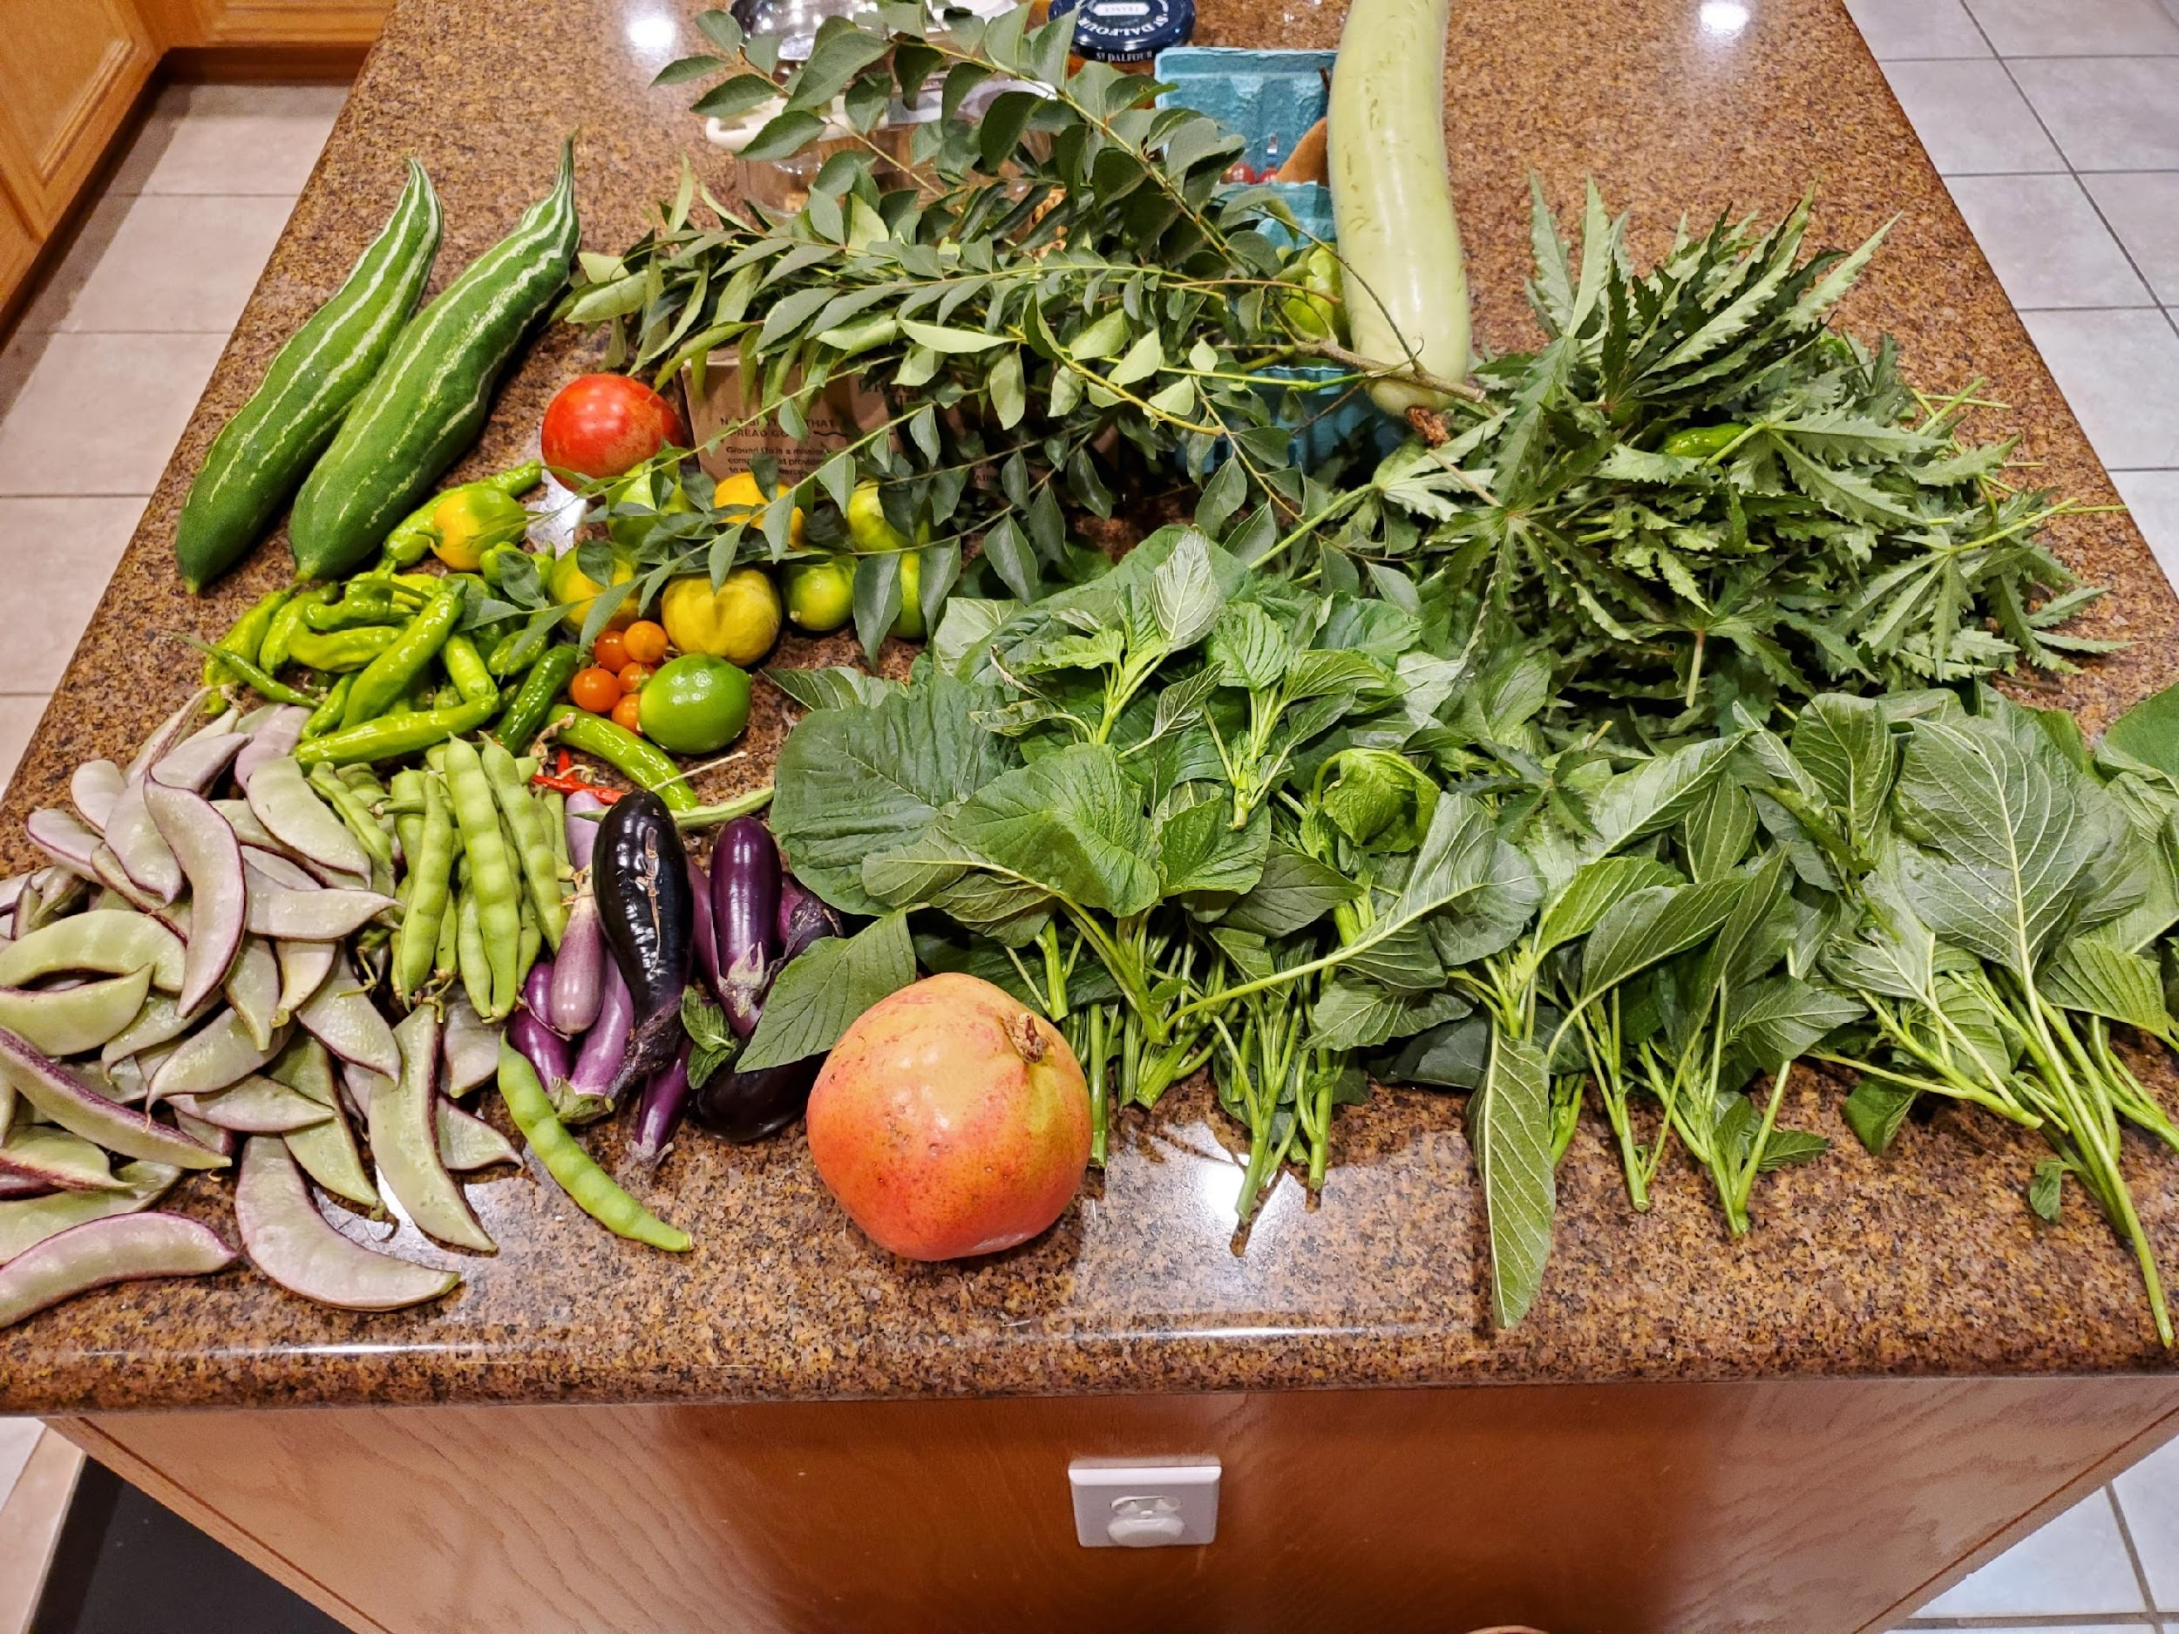
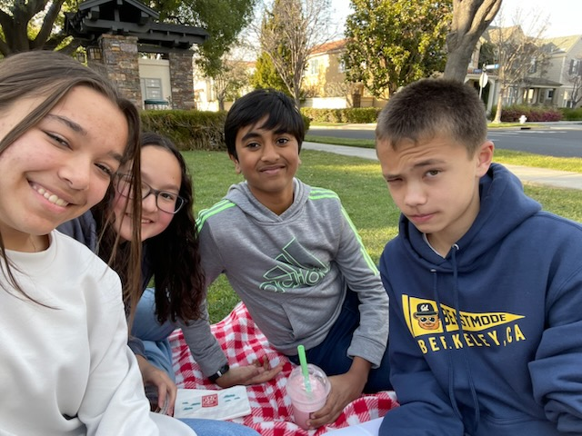
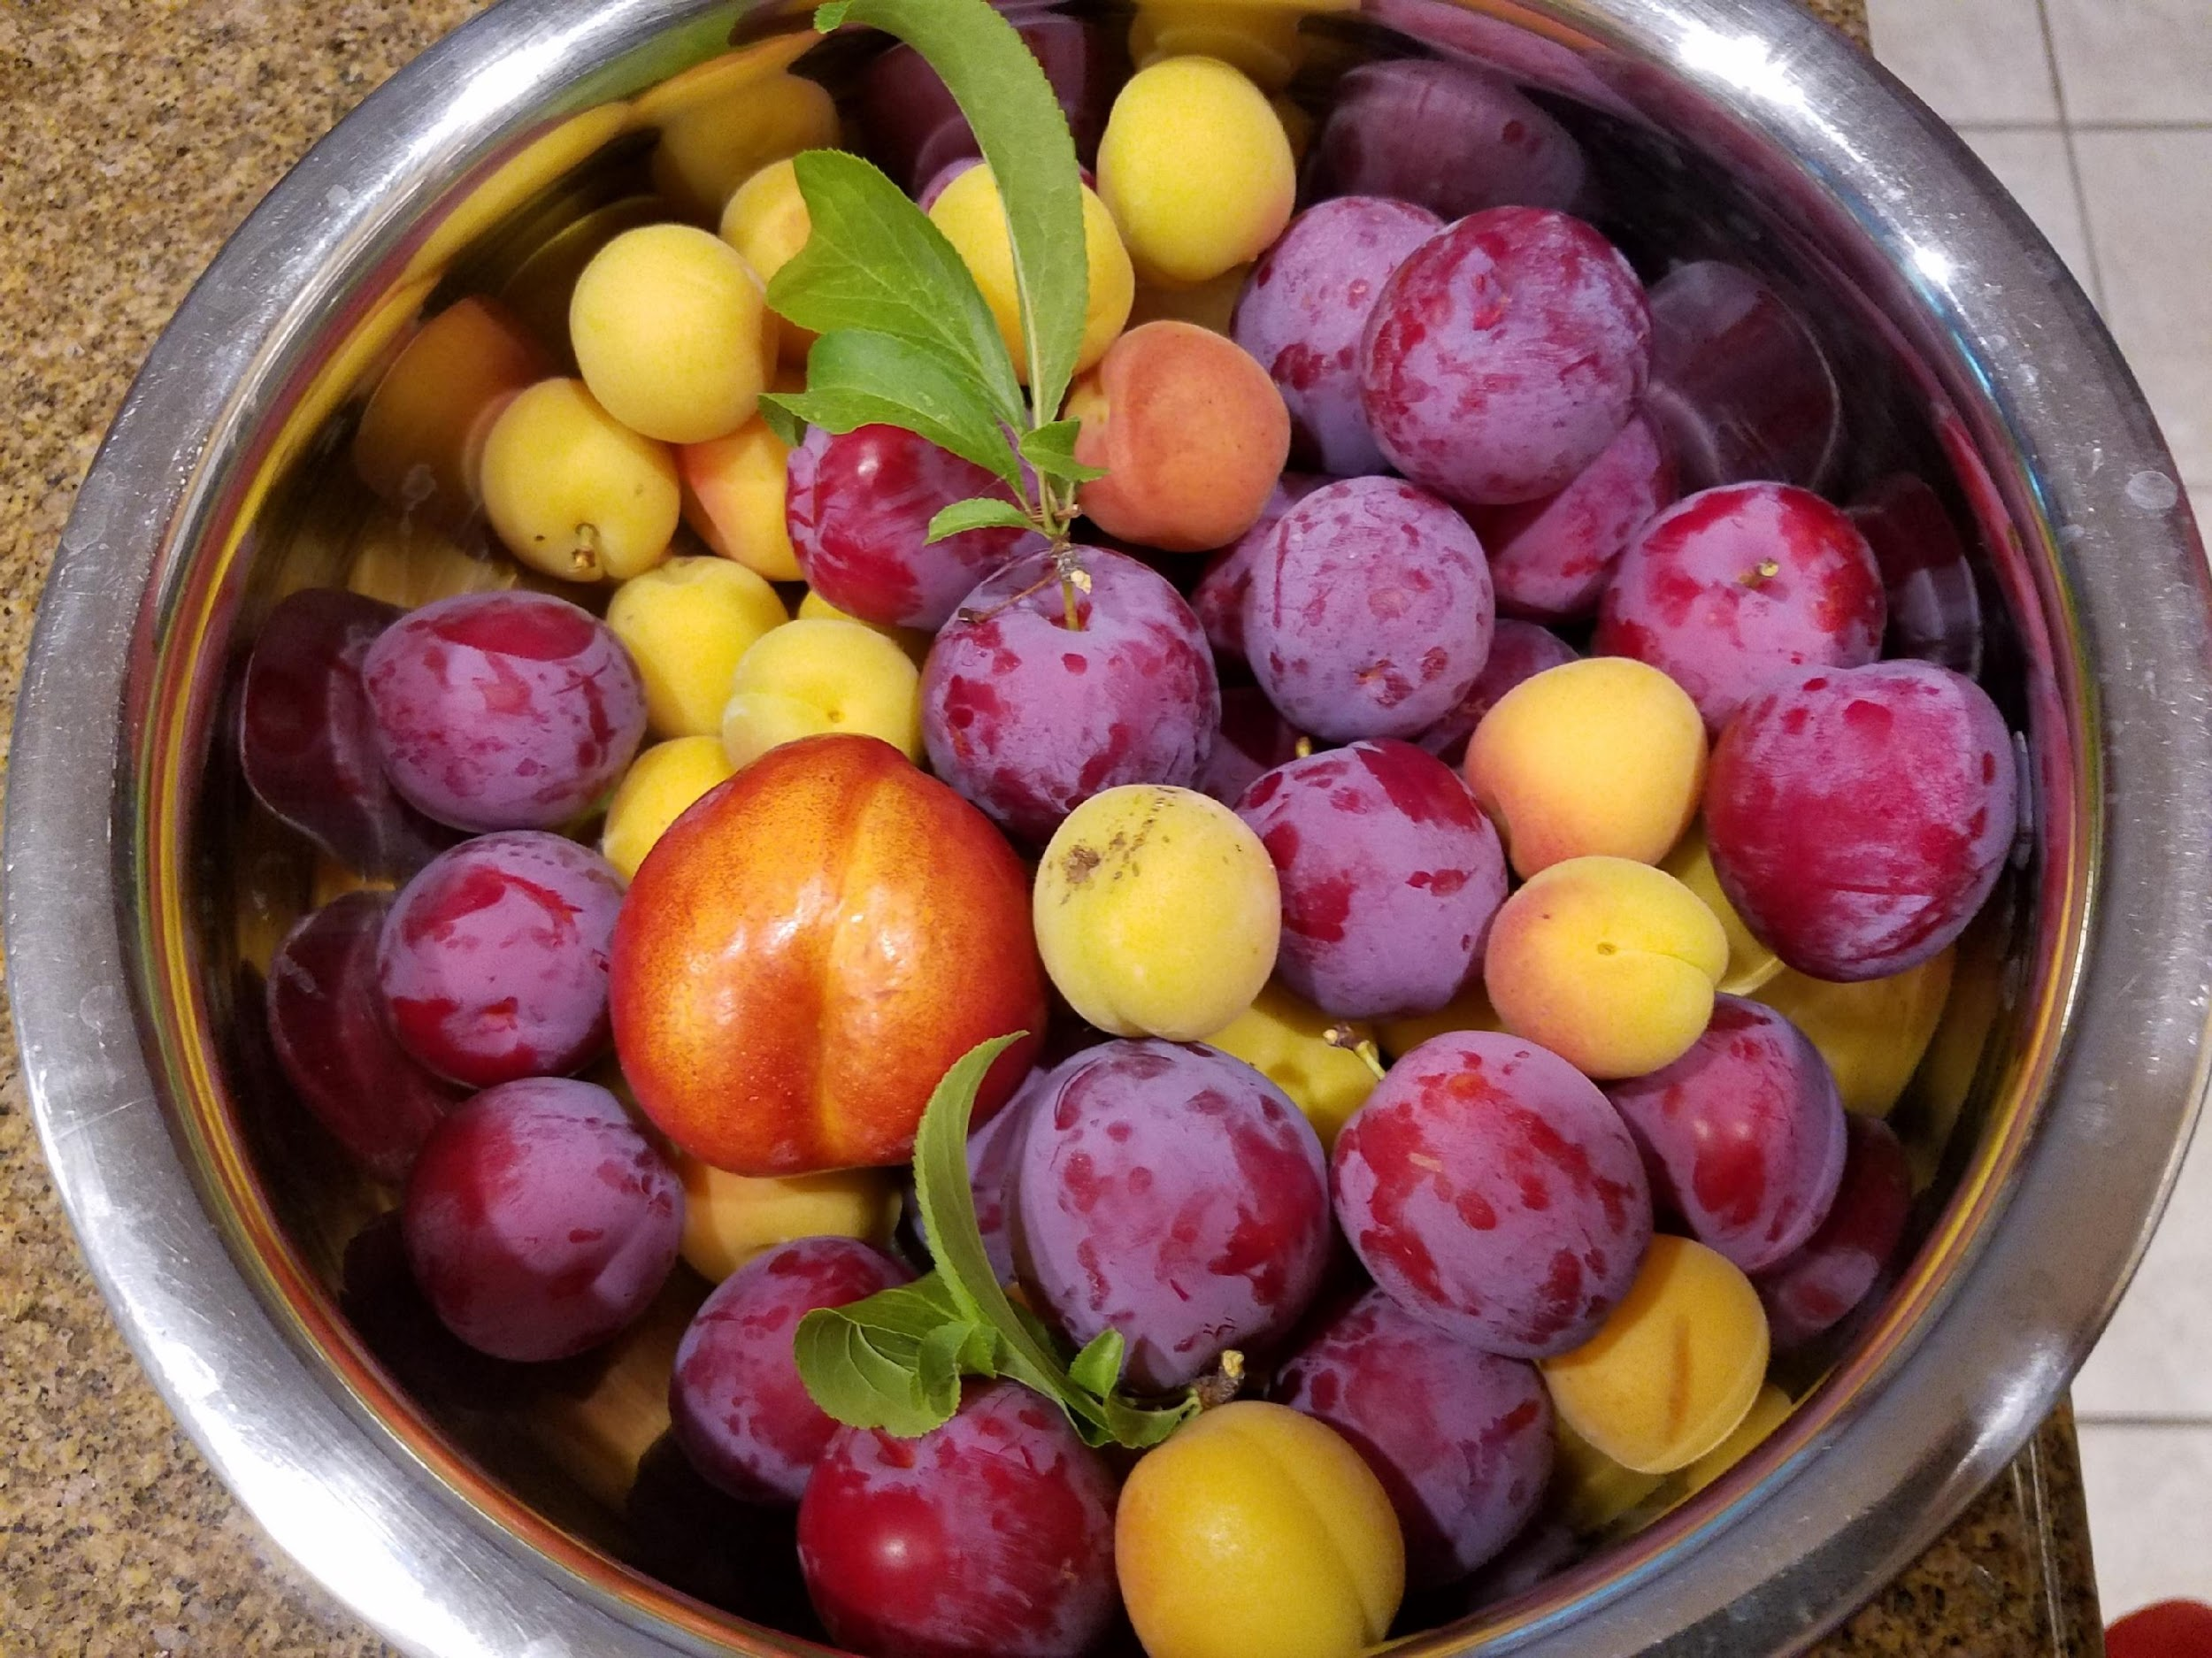

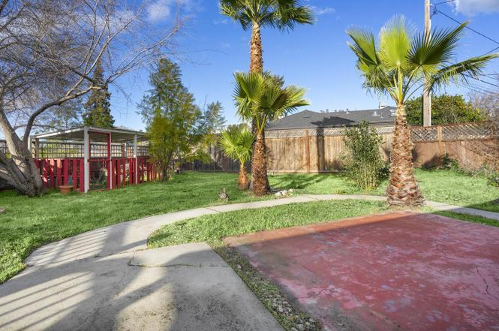


Notes:
Vienna-Saizberg-Budapest-Prague-Zurich-Swiss Alps
Matt Schwarz
Brahma chickens are probably my favorite. They are a bigger chicken, so they lay large eggs, and quite often I'll get double yokers(two yokes in one egg) and once before even had a triple yoker. They are also very docile and friendly.
I've got a mix though of chickens, with some ancona, australorp, orpington, plymoth rock, and silkie. Silkie's give tiny eggs, but they are great mothers if you want yours to hatch their own. Right now, we don't have any roosters, but have had in the past, and they have always been our most successful mothers at hatching and raising the chicks. And chickens don't differentiate their eggs from others, so they can hatch and raise a flock of a mix.

Slide 4
Synopsis of the Company
AnyCompany – mid size FinTech
Choose industry and customer you like
Choose the persona you want to tackle
Data Engineering
Security Admin
Data Scientist
Data Analyst
DO NOT CHOOSE MULTIPLE PERSONAS; YOU WILL NOT BE ABLE TO SUCCESSFULLY DEMONSTRATE VALUE IN 60 MINUTES
Notes:
Data Engineering – creating ETL pipelines, build & maintain data infra. - create and manage data systems
Data Analyst – visualizes & validating data – uses data systems.

Slide 5
Business Challenges
What is the business problem?
Rising fraud attempts + chargebacks; manual triage is reactive
Credit decisions inconsistent; hard to explain & audit
Siloed analytics; no single source for customers/transactions
What is the impact internal/external?
Customer retention
Revenue loss
Portfolio management
Audit/Risk assessments

Slide 6
Technical Challenges
What are the technical challenges causing these business problems?
Scalability & concurrency: ETL + BI contend for resources; small files; slow queries.
Data silos & copies: multiple tools, duplicated pipelines, inconsistent truths.
Latency / streaming: need near-real-time fraud features and alerting.
Multi-cloud / openness: avoid lock-in; interop with other engines.
Collaboration & reuse: DE/DS/BI on different stacks; hard to share features.
Governance & audit: PII controls, lineage, and access at column/table level.
Ops & cost: cluster wrangling, quotas, complex scheduling & monitoring.
Governance gaps on PII: limited lineage/traceability
Fragmented stack: data copied across tools; slow fraud/risk decisions
Notes:
"Cluster wrangling" refers to the practice of cleaning, organizing, securing, and optimizing data or compute clusters

Slide 7
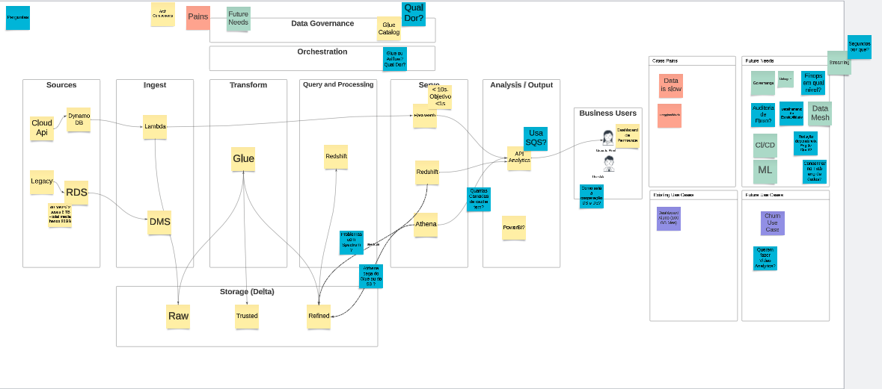
Current State Architecture
Current State Assessment
Architecture
Challenges / future needs
Use cases
Desired state

Slide 8





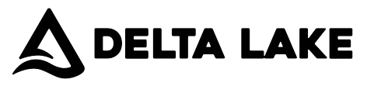


Databricks Data Intelligence Platform
100% serverless
Disaster recovery
Cost controls
Enterprise security
Databricks SQL
Data warehousing
Workflows/DLT
Ingest, ETL, streaming
Mosaic AI
Artificial intelligence
AI/BI
Business intelligence
Lakehouse
Notes:
DB Benefits:
Faster time-to-insight: single platform; Serverless SQL + Jobs → minutes to refresh (Job run).
Lower cost & simpler ops: one copy on Delta; no cross-tool hops; serverless autoscale.
Better risk control: fraud features + rules (v_fraud_alerts), credit PD heatmap, RFM segments.
Governed by design: Unity Catalog masks, tags, RBAC, and Lineage from S3→Gold→Dashboard.
Open & future-proof: Parquet export on S3 + external tables; path to DLT streaming & Mosaic AI
–
🔹 1. Simplify the Architecture
Current:
Multiple tools for ETL (Glue, Lambda, DMS), query (Redshift, Athena), and analytics (Power BI).
Data duplication across Redshift, S3, and Athena.
Complex data lineage and governance.
Future (Databricks):
One platform for ingestion, transformation, warehousing, and AI.
Delta Live Tables (DLT) or Workflows replace Glue + Lambda + DMS.
Single storage layer (Delta Lake) with ACID transactions.
🗣️ Talking point: “We can reduce tool sprawl and manage our entire data lifecycle—ETL, SQL analytics, and ML—on one platform.”
🔹 2. Eliminate Data Silos
Current:
Glue ETL writes to S3 → Redshift → BI tools.
Data copied across environments → inconsistent truths.
Future (Databricks):
Unified data under Delta Lake with Unity Catalog for governance.
Bronze–Silver–Gold tables provide a consistent, governed data model.
🗣️ Talking point: “Unity Catalog ensures a single source of truth across all personas—Data Engineering, BI, and AI.”
🔹 3. Improve Performance and Scalability
Current:
Redshift and Athena compete for resources.
Manual tuning and scaling.
Future:
Serverless SQL warehouse automatically scales.
Delta caching and Z-ordering improve performance on large datasets.
🗣️ Talking point: “Databricks’ serverless SQL gives instant scalability and faster query performance without manual ops.”
🔹 4. Enable Real-Time & AI Capabilities
Current:
Glue batch jobs → hours of latency.
No native ML integration.
Future:
Streaming ingestion via DLT or Auto Loader.
Mosaic AI + MLflow for native AI/ML experimentation on the same data.
🗣️ Talking point: “We move from static reports to real-time risk detection and AI-powered insights.”
🔹 5. Strengthen Data Governance & Security
Current:
Data access managed separately in Glue, Redshift, and S3 IAM policies.
No centralized audit or lineage.
Future:
Unity Catalog centralizes governance—data, models, and notebooks.
Row- and column-level access control.
🗣️ Talking point: “Unity Catalog provides unified governance—secure, auditable access across all data assets.”
🔹 6. Reduce Cost & Operational Overhead
Current:
Multiple AWS services = multiple cost points.
Heavy DevOps maintenance for pipelines and clusters.
Future:
100% serverless compute for ETL, SQL, and AI.
Pay only for compute used.
🗣️ Talking point: “We cut cost and maintenance by consolidating compute and storage under Databricks’ serverless model.”
🔹 7. Future-Ready Foundation
Current:
Difficult to extend into ML, GenAI, or governance frameworks.
Future:
Built-in Mosaic AI and Delta Sharing support.
Ready for data mesh or federated data governance.
🗣️ Talking point: “Databricks sets us up for future use cases like GenAI, federated governance, and real-time analytics.”
On top of this open lakehouse foundation, you’re able to execute all of your data and AI initiatives
Mosaic AI provides end-to-end AI for both generative and classical AI
Notebooks offer a deep set of data science capabilities
Databricks SQL offers the most performant data warehouse in the cloud
AI/BI integrates deeply with Databricks SQL to easily extend business intelligence across the business
And LakeFlow ensures that you can reliably ingest and transform all of the data these workloads require

Slide 9
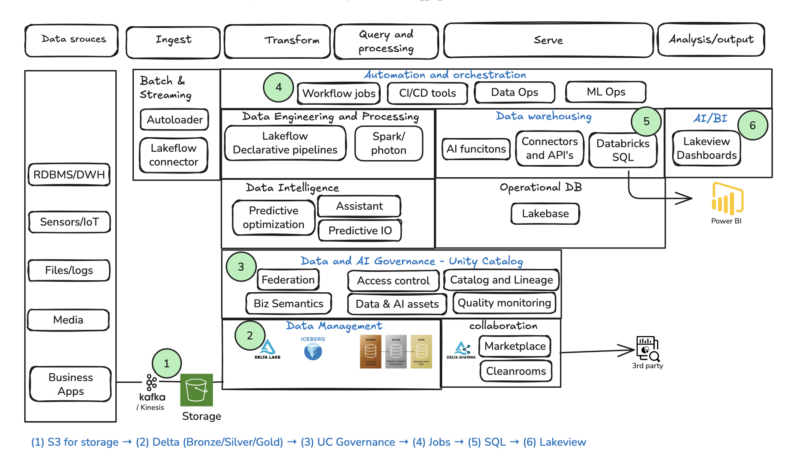
Recommended/Future State Architecture (based on what you know)
Target Architecture - presentation
Lakehouse target architecture
High-level use case mapping
Customer benefits
Notes:
Bronze-Silver-Gold Medallion Architecture

Slide 10
Demo

Slide 11
Demo: Tell-Show-Tell
S3 → UC: “Data lands once in S3 → Delta under Unity Catalog.”
Delta proof: open transactions_silver → History and VERSION AS OF query.
Dashboard:
Fraud bubbles (time × score, size=amount)
Credit heatmap (bureau band × delinq → avg PD)
Segments bar (customers by segment)
Governance: open Lineage, show masked columns + tags.
Jobs: show Bronze→Silver→Gold→Governance scheduled on Serverless.
Open formats: show Parquet folder in S3 + query external table.
Close: “Same tables power ETL + ML + BI. Streaming-ready. Less copy & cost, Open formats. Governed.”
“On the Databricks Lakehouse we landed data once in S3 and ran ETL, analytics, and ML on the same Delta tables, fully governed by Unity Catalog. We delivered three fintech outcomes—real-time fraud triage, credit risk scoring, and customer segmentation—orchestrated with serverless Jobs and visualized in Lakeview. The platform gives us speed, lower cost, stronger governance, and no lock-in (we even exported open Parquet), so the business gets faster decisions with less risk and simpler ops.”
Notes:
Convert delta tables to parquet format
SELECT * FROM fin.curated.transactions_silver;
-- Gold fraud
INSERT OVERWRITE DIRECTORY 's3://payer-demo-ur/fin/parquet/fraud_scored/'
USING PARQUET
SELECT * FROM fin.curated.fraud_scored_gold;
-- Gold credit risk
INSERT OVERWRITE DIRECTORY 's3://payer-demo-ur/fin/parquet/credit_risk/'
USING PARQUET
SELECT * FROM fin.curated.credit_risk_scores_gold;
-- Gold segments
INSERT OVERWRITE DIRECTORY 's3://payer-demo-ur/fin/parquet/segments/'
USING PARQUET
SELECT * FROM fin.curated.customer_rfm_gold;

Slide 12
Recap and tie business values to Databricks solution
Use-cases
Fraud detection on card/payments
Credit risk scoring for loan/CC applications
Customer segmentation (RFM: recency/frequency/monetary)
What we proved:
Fraud triage: velocity features + rules → high-risk spikes surfaced in minutes
Credit risk: PD heatmap by bureau band × delinquencies (clear risk gradients)
Segments: RFM cohorts with counts & avg spend
Governance: column masking, tags, end-to-end lineage in UC
Orchestration: Job runs Bronze→Silver→Gold; scheduled, idempotent
Openness: same gold tables exported to Parquet on S3

Slide 13
Next Steps
Recommended next steps
DBX SA to provide help in building PoC in customer env?
Commitment on next steps
Solution updates:
Add streaming for fraud
train a proper credit model (AutoML), add feature store,
Enforce row/column-level policies with UC for least privilege.

Slide 14
Thanks

Slide 15
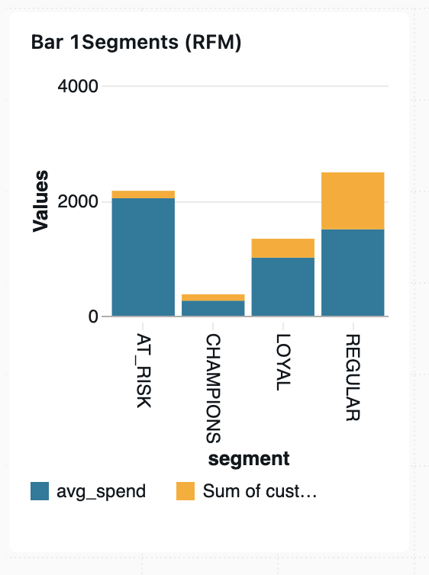
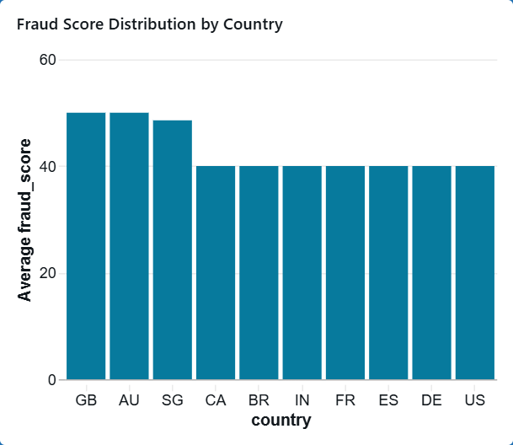
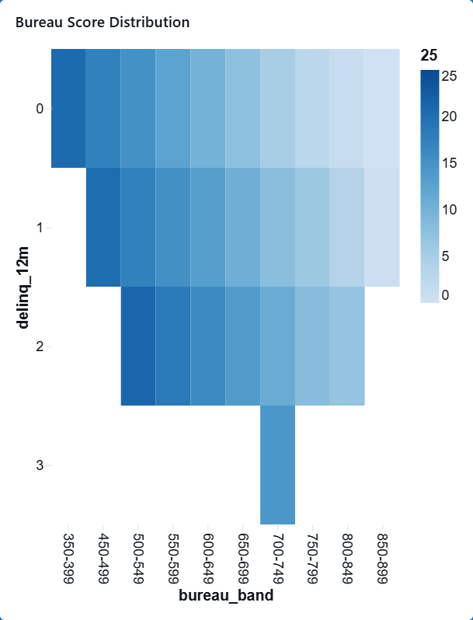
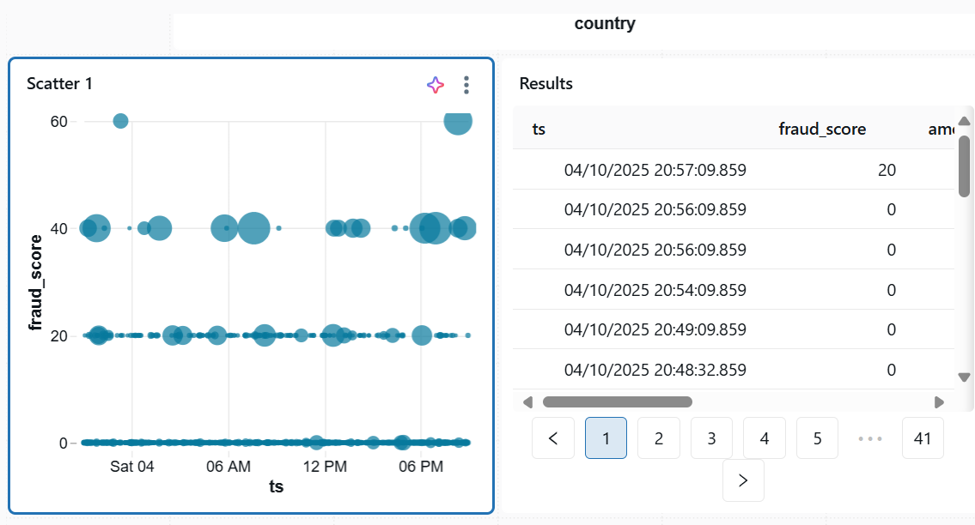
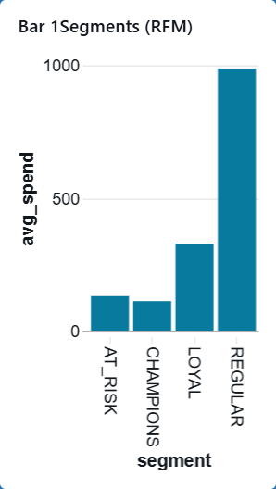
Dashboard
Credit Probability of Default (0-25)
Notes:
Credit Heatmap 0-25 is average PD (probability of default)

Slide 16
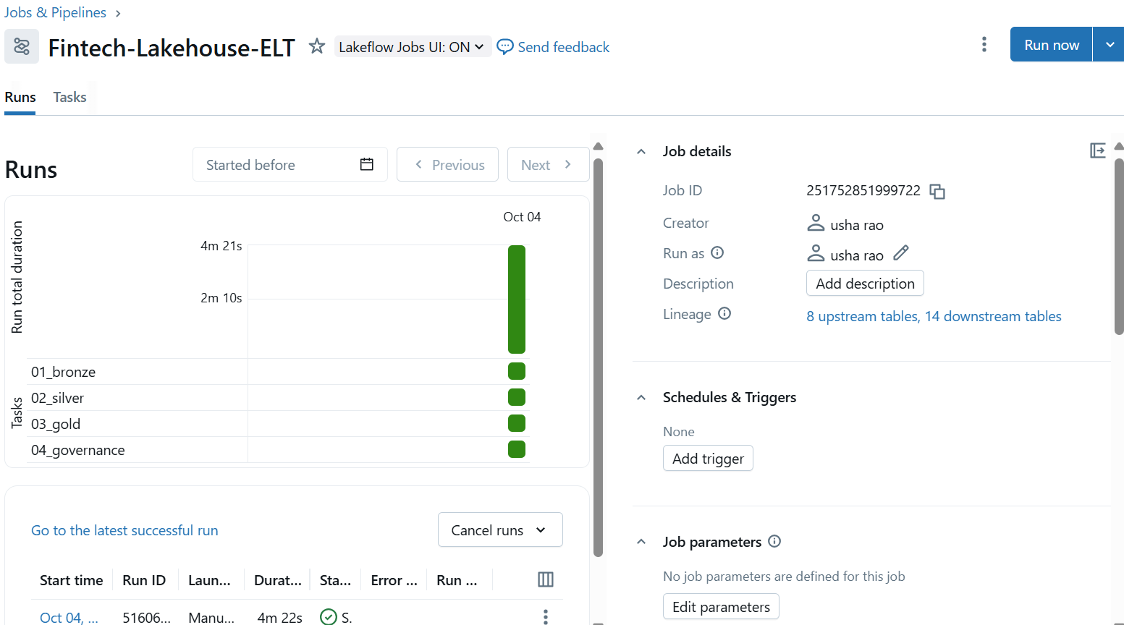
Workflow automation -jobs
Notes:
“Lineage is the auto-captured, column-aware map of how data flows through Lakehouse—from raw S3 files to Bronze/Silver/Gold tables to Jobs and dashboards—so we can do impact analysis, auditing, and debugging in seconds.”

